Slide 1
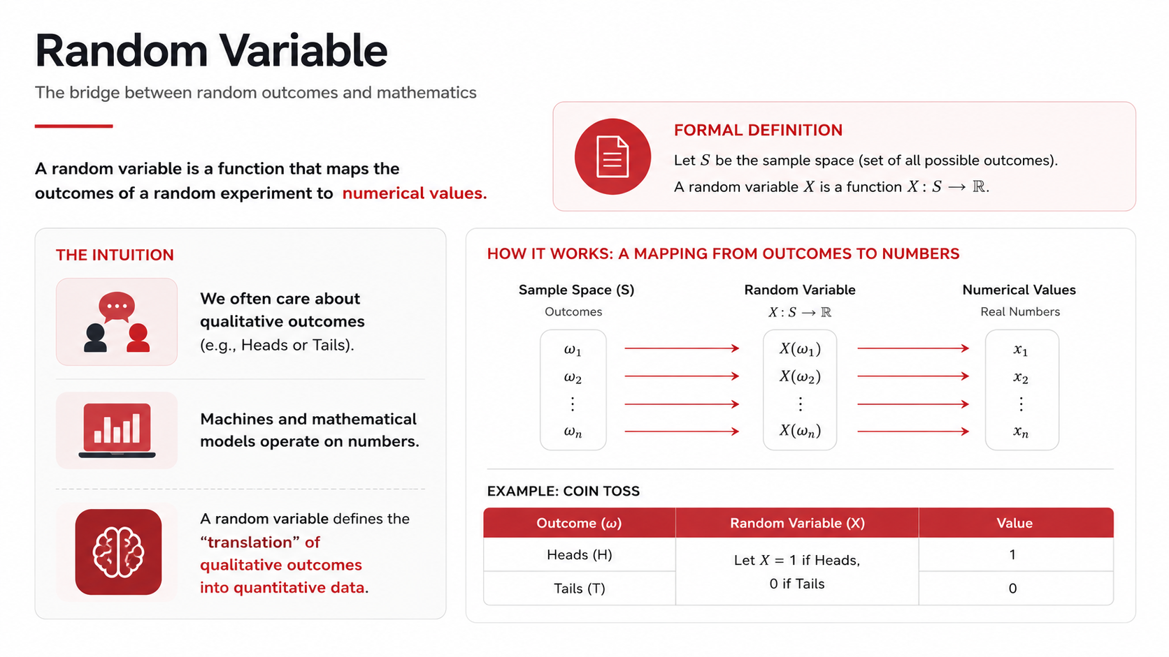
Random Variable
The bridge between random outcomes and mathematics
FORMAL DEFINITION
A random variable is a function that maps the
outcomes of a random experiment to
Let S be the sample space (set of all possible outcomes)_
random variable X is a function X: S
numerical values:
RJ
THE INTUITION
HOW IT WORKS: A MAPPING FROM OUTCOMES TO NUMBERS
We often care about
qualitative outcomes
(e.g , Heads or Tails).
Sample Space (S)
Random Variable
Numerical Values
Real Numbers
Outcomes
X:$
W1
W2
X(61)
X(@z)
X1
X2
Machines and mathematical
models operate on numbers:
X(@n)
Wn
Xn
EXAMPLE: COIN TOSS
random variable defines the
"translation" of
qualitative outcomes
into quantitative data_
Outcome (w)
Random Variable (X)
Value
Heads (H)
Let X = 1 if Heads_
Tails (T)
0 if Tails

